Slide 1



gofrugal
First company to offer the cloud and mobile ERP solutions.

Slide 2
Gofrugal is a digital-first company that offers cloud and mobile ERP solutions to Retail, Restaurant, and Distribution business¹². Established in 2004, Gofrugal helps businesses embrace agility and transform digitally to stay competitive in the dynamic market

Slide 3
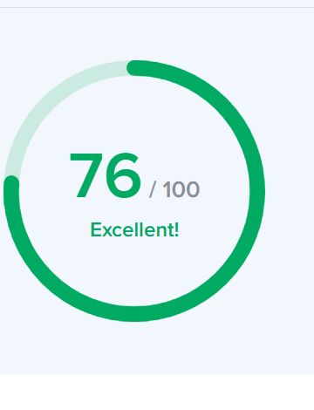
Seo audit
In this website there are 22 items
Out of 22 items, there are 6 items are in danger.
16 out of 22 are good in Seo
The Seo is at the result of 60 to 80, but this website has scored 76 , it means it has an a very good optimization.

Slide 4
Strengths and weakness
Strength:
This website has been designed well.
While the Seo is also been excellent while it has been showing 76 out of 100.
The SEO title is set and is 73 characters long.
The site has a robots.txt file.
Weakness
1.The meta description is 269 characters long
2.Some images in the page no alt attributes.
3.Some open tag meta tag’s are missing.
4. The server is not using ‘expires’ headers for the images.
5. Some JavaScript files don’t seen to be minified.

Slide 5
Keywords keyword volume difficulty
Free tier cloud service. 1.9k n/a
2. Free cloud service like Heroku 1.9k n/a
3.What is a good cloud gaming service 1.9k n/a
4.online store management system 30 n/a

Slide 6
Competitor keywords and strategies
1.Tally prime
2.Restwork
3.Busy accounting
4.My bill book
5.Redbook
Strategies:
It can adopt so many strategies for its growth
1.Expansion of its products and services
2. Focusing on customer support.
3,giving a tutorial for their product use

Slide 7
On page Seo optimization audit
Page-1 : retail
1.In this page their proper use of keywords in the content and the heading.
2.In this page internal linking and external linking are perfect.
Here, there is a use internal linking-101 and external linking-4
3.There is a proper use alt text for all images and proper use of descriptive files also.
4.The title tags , meta descriptions and html tags are good
5. But the open meta tags are missing.

Slide 8
On page Seo optimization audit
Page-2 : restaurant
1.In this page their proper use of keywords in the content and the heading.
2.In this page internal linking and external linking are perfect.
Here, there is a use internal linking-43 and external linking-4
3.There is a proper use alt text for all images and proper use of descriptive files also.
4.The title tags and html tags are good
5. But the open meta tags are missing.
6.But the description 161 has 161 characters long.

Slide 9
On page Seo optimization audit
Page-3 : distribution
1.In this page their proper use of keywords in the content and the heading.
2.In this page internal linking and external linking are perfect.
Here, there is a use internal linking-39 and external linking-3
3.There is a proper use alt text for all images and proper use of descriptive files also.
4.The title tag and html tags are good
5. But the open meta tags are missing.
6.The meta description is 191 characters long.

Slide 10
5 Best practices that improve the website
Optimize images
Enable browser caching
Reduce http requests
Use content delivery network(can)
For site.
1.Improve navigation
2.Improve the loading time.
3.Use a high quality content.
4.Enhance the visuals.

Slide 11
Content strategy plan for keyword
1.Audience research
2. Content types
3. Content distribution
Identify the target audience like business(small), startups, developers, students, and tech enthusiasts.
Understand their troubling points-like the cost of cloud solutions, learning cloud computing.
Blog posts
Tutorials and guides
Case studies
Videos
infographics
Social media
email Newsletter
Seo optimization
partnership

Slide 12
Content strategy plan for keyword
4. Content calendar
5. Engagement and interaction
6.Performance and tracking
a.Plan a monthly content calendar with specific topics and deadlines for each piece of content.
b.Ensure a mix of content types to keep the audience engaged and informed.
Q&A sessions
Webinars
Community building
Analytics
feedback

Slide 13


Off page Seo plan and strategy
Link building
Content marketing
Social media marketing
Community engagement

Slide 14
Off page Seo plan and strategy
partnership
Email marketing
PR and media outreach
Also try to know about the customer feedback

Slide 15

Thank you
Poojitha velagala
velagalapoojitha2002@gmail.com
9705283674

